Slide 1
Big Data Analytics (CS4033)
Mr. Dipak R. Patil (ME CSE)
Assistant Professor
Department of Computer Engineering

Slide 2

Types of Data
Quantitative Data
• Measurable
• Collected through measuring things that have a fixed reality
• Close ended
Qualitative Data
• Descriptive
• Collected through observation, field work, focus groups, interviews, recording or filming conversations
• Open ended

Slide 3
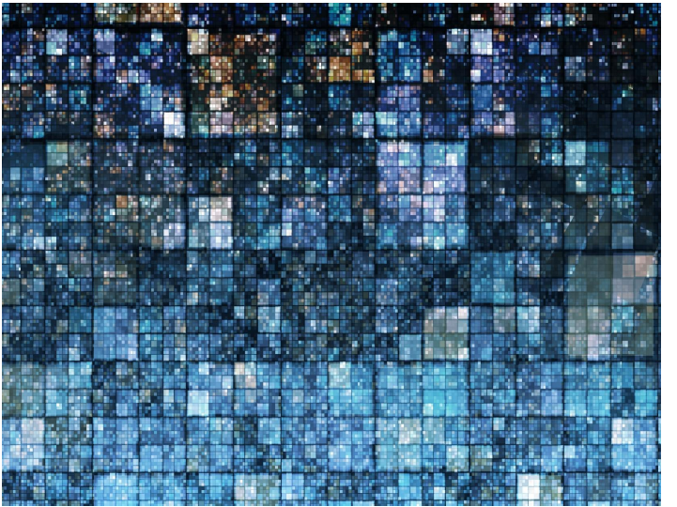
Big Data
Data that is too large or too complex to be managed using traditional data processing, analysis, and storage techniques.

Slide 4
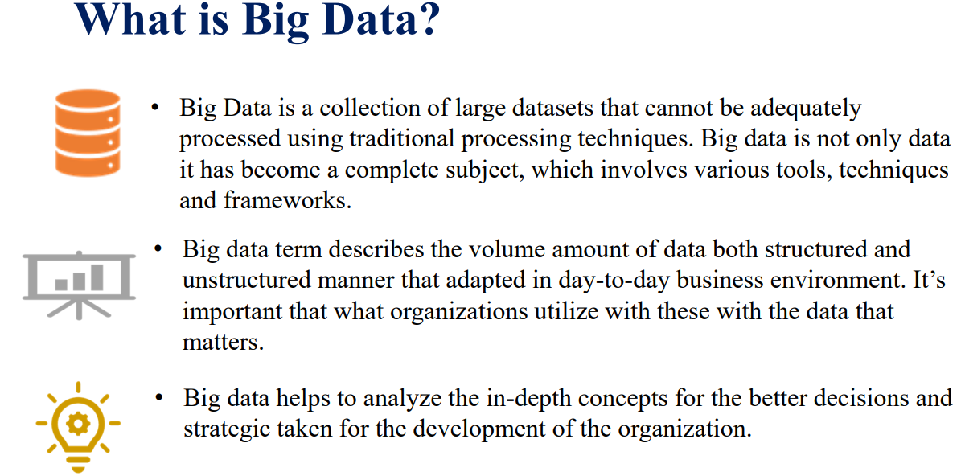

Slide 5
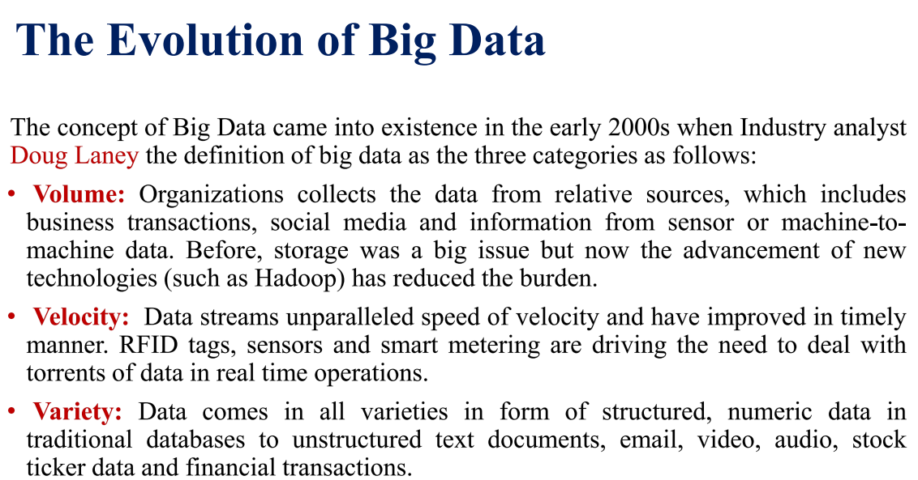

Slide 6
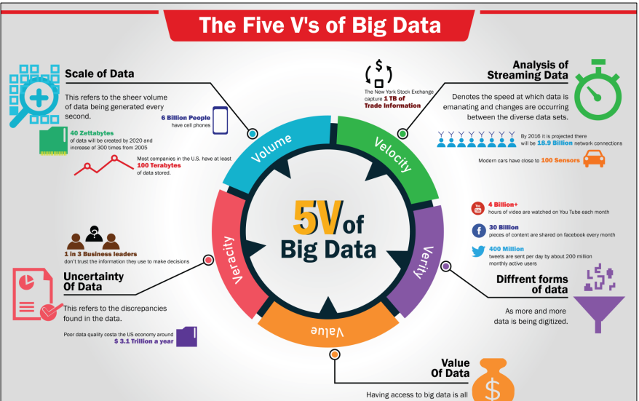

Slide 7
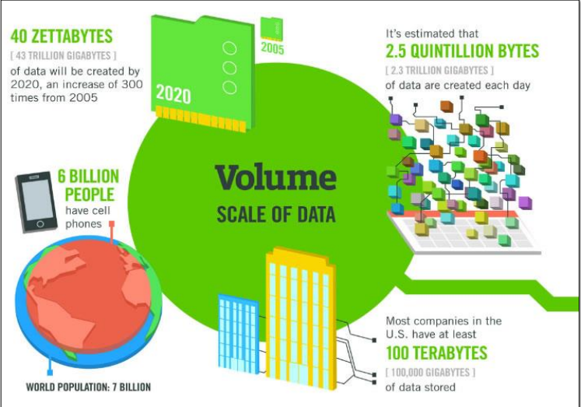

Slide 8
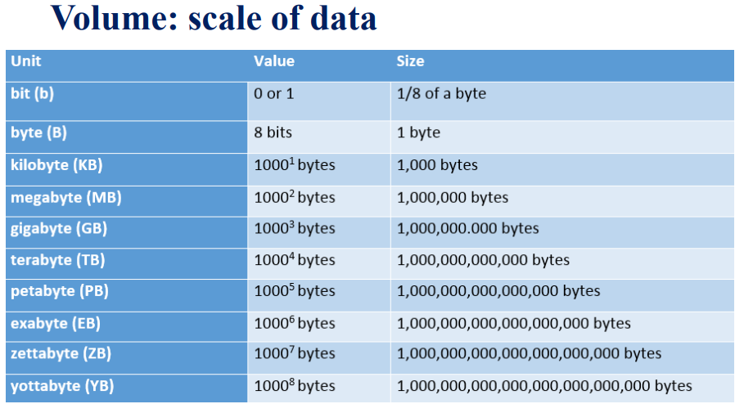

Slide 9
Volume: scale of data
90% of today’s data has been created in just the last 2 years
Every day we create 2.5 quintillion bytes of data or enough to fill 10 million Blu-ray discs
40 zettabytes (4o trillion gigabytes) of data will be created by 2020, an increase of 300 times from 2005, and the equivalent of 5,200 gigabytes of data for every man, woman and child on Earth
Most companies in the US have over 100 terabytes (100,000 gigabytes) of data stored

Slide 10
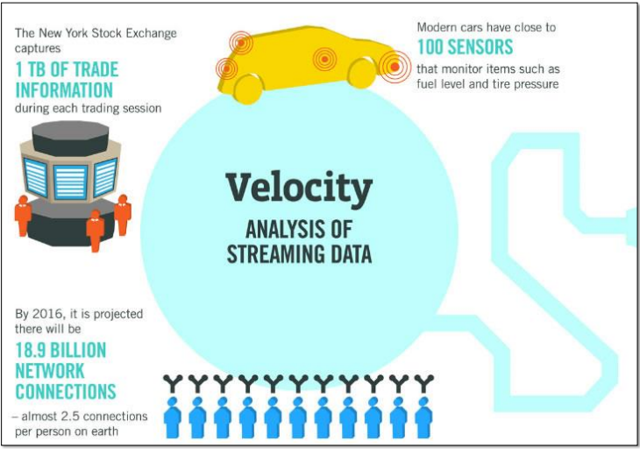

Slide 11
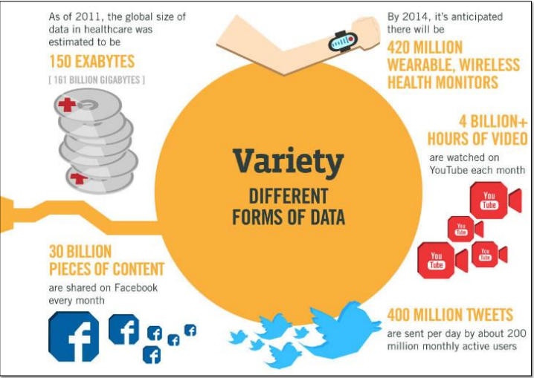

Slide 12
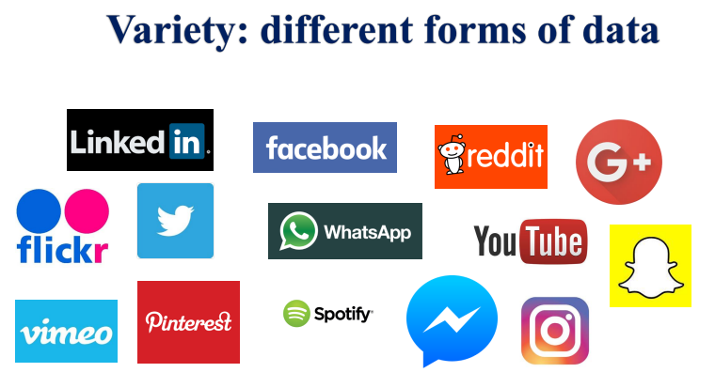

Slide 13
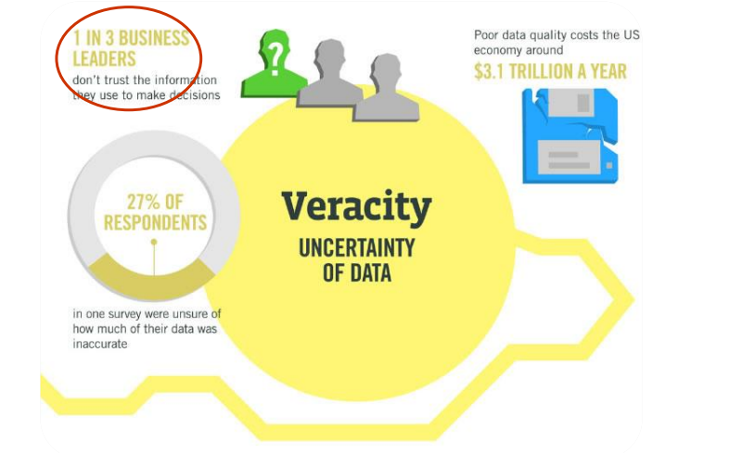

Slide 14
Industry examples of big data
Digital marketing
Fraud and big data
Risk and big data Credit risk management
Big data and algorithmic trading
Big data and healthcare
Advertising and big data
Cloud and big data
Mobile business intelligence
Crowdsourcing analytics
Inter and Trans-firewall analytics

Slide 15
Retail and E-Commerce:
Customer Analytics: Retailers use big data to analyze customer behavior, such as purchase history, browsing patterns, and demographics, to personalize marketing campaigns and improve customer experiences.
Inventory Management: Retailers optimize inventory levels using predictive analytics to ensure products are in stock when and where customers need them.
Healthcare:
Clinical Data Analysis: Healthcare providers analyze patient records, medical images, and genetic data to enhance diagnoses, treatment plans, and patient outcomes.
Drug Discovery: Pharmaceutical companies use big data to accelerate drug discovery processes by analyzing large datasets for potential drug candidates.
Finance:
Risk Management: Banks and financial institutions use big data for credit scoring, fraud detection, and assessing market risks.
Algorithmic Trading: High-frequency trading firms leverage big data and machine learning algorithms for real-time decision-making in financial markets.
Manufacturing:
Predictive Maintenance: Manufacturers use sensor data from machines and equipment to predict when maintenance is needed, reducing downtime and costs.
Supply Chain Optimization: Big data helps optimize supply chain operations by analyzing data related to logistics, inventory, and demand forecasting.

Slide 16
Energy and Utilities:
Smart Grids: Utility companies use big data to monitor and optimize the electrical grid, leading to more efficient energy distribution and reduced outages.
Energy Consumption Analysis: Big data helps households and businesses monitor and reduce energy consumption through smart meters and analytics.
Transportation and Logistics:
Route Optimization: Logistics companies use big data to optimize delivery routes, reducing fuel consumption and improving delivery times.
Fleet Management: Fleet operators use big data to monitor vehicle health, driver behavior, and fuel efficiency.
Telecommunications:
Network Optimization: Telecom providers analyze network data to optimize performance, detect issues, and plan for capacity expansion.
Customer Churn Prediction: Big data is used to predict and reduce customer churn by analyzing call records and customer interactions.
Media and Entertainment:
Content Recommendation: Streaming platforms use big data to recommend personalized content to users based on their viewing history and preferences.
Audience Engagement: Media companies analyze social media and viewer engagement data to tailor marketing campaigns and content.
Agriculture:
Precision Agriculture: Farmers use big data to optimize planting, irrigation, and harvesting by analyzing data from sensors, satellites, and weather forecasts.
Crop Disease Detection: Image analysis and sensor data help identify crop diseases early for targeted treatment.

Slide 17
Thank You

